Slide 1
Array Data STructure
Applications of Array Data Structure:
Arrays are used to implement data structures like a stack, queue, etc.
Arrays are used for matrices and other mathematical implementations.
Arrays are used in lookup tables in computers.
Arrays can be used for CPU scheduling.
Real-Time Applications of Array:
Contact lists on mobile phones.
Matrices use arrays which are used in different fields like image processing, computer graphics, and many more.
Arrays are used in online ticket booking portals.
Pages of book.
IoT applications use arrays as we know that the number of values in an array will remain constant, and also that the accessing will be faster.
It is also utilized in speech processing, where each speech signal is represented by an array.
The viewing screen of any desktop/laptop is also a multidimensional array of pixels.

Slide 2
Applications of Array in C/C++
Arrays are used to implement vectors, and lists in C++ STL.
Arrays are used as the base of all sorting algorithms.
Arrays are used to implement other DS like a stack, queue, etc.
Used for implementing matrices.
Data structures like trees also sometimes use the array implementation since arrays are easier to handle than pointers. For example, a segment tree uses array implementation.
Binary search trees and balanced binary trees are used in data structures such as a heap, map, and set, which can be built using arrays.
Graphs are also implemented as arrays in the form of an adjacency matrix.

Slide 3
Advantages of array data structure
Arrays store multiple data of similar types with the same name.
It allows random access to elements.
As the array is of fixed size and stored in contiguous memory locations there is no memory shortage or overflow.
It is helpful to store any type of data with a fixed size.
Since the elements in the array are stored at contiguous memory locations it is easy to iterate in this data structure and unit time is required to access an element if the index is known.

Slide 4
Disadvantages of array data structure
The size of the array should be known in advance.
The array is a static data structure with a fixed size so, the size of the array cannot be modified further and hence no modification can be done during runtime.
Insertion and deletion operations are costly in arrays as elements are stored in contiguous memory.
If the size of the declared array is more than the required size then, it can lead to memory wastage.

Slide 5
Advantages of Structure over Array
The structure can store different types of data whereas an array can only store similar data types.
Structure does not have limited size like an array.
Structure elements may or may not be stored in contiguous locations but array elements are stored in contiguous locations.
In structures, object instantiation is possible whereas in arrays objects are not possible.

Slide 6
Data Structure and Algorithm
Chapter 3
List
Data Structures

Slide 7
Contents
List ADT
Array implementation of List ADT,
Operations
Time and space complexity of array implementation
Linked list:-
Singly linked lists,
doubly linked lists,
circular (singly and doubly) linked lists,
Operations on linked lists:
creation, insertion, deletion, update, search

Slide 8
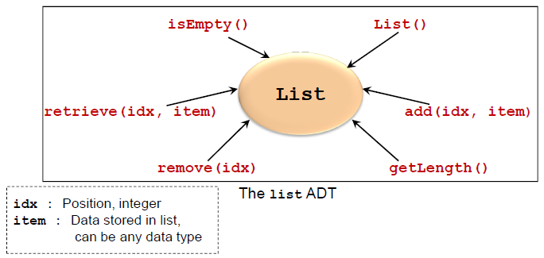
List adt
A list contains elements of same type arranged in sequential order.
Lists are very common in computing
e.g. student list, list of events, list of appointments etc
Two Major Implementations
Array implementation
Linked list implementation

Slide 9
Array Implementation of list adt
Array is a list of a finite number n of homogeneous data elements
The elements of the array are stored respectively in successive memory locations.
Array is a prime candidate for implementing list ADT
Simple construct to handle a collection of items
Operations
addAt(), removeAt(), getSize(), isEmpty()…etc.
Advantage:
Very fast retrieval

Slide 10
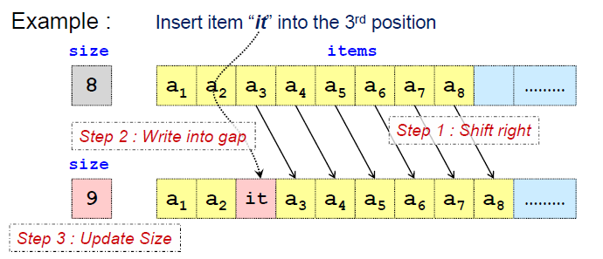
Insertion : Using Array
Simplest Case: Insert to the end of array
Other Insertions:
Some items in the list needs to be shifted
Worst case: Inserting at the head of array

Slide 11
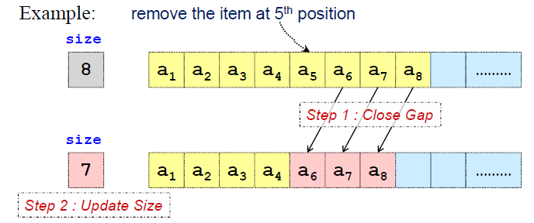
Deletion: Using Array
Simplest Case: Delete item from the end of array
Other deletions:
Items needs to be shifted
Worst Case: Deleting at the head of array

Slide 12
Array Implementation: Efficiency (time)
Retrieval:
Fast: one access
Insertion:
Best case: No shifting of elements
Worst case: Shifting of all N elements.
Deletion:
Best case: No shifting of elements
Worst case: Shifting of all N elements

Slide 13
Array Implementation : Efficiency (space)
Size of array is restricted to MAX_LIST
Problem:
Maximum size is not known in advance
Solution:
Make MAX_LIST a variable
When array is full:
1. Create a larger array
2. Move the elements from the old array to the new array
No more limits on size, but space wastage and copying overhead is still a problem
MAX_LIST is too big == unused space is wasted
MAX_LIST is too small == run out of space easily

Slide 14
Array Implementation : Summary
For fixed-size collections
Arrays are great
For variable-size collections, where dynamic operations such as insert/delete are common
Array is a poor choice of data structure
For such applications, there is a better way……
Limitation of Array
Changing the size of the array requires creating a new array
Inserting/deleting an item requires shifting

Slide 15
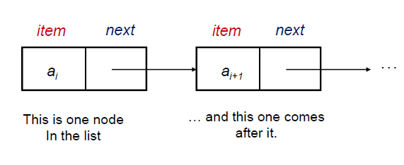
Linked list
A linked list consists of a finite sequence of elements or nodes (not necessarily adjacent in memory) that contain information plus (except possibly the last one) a link to another node.
Unlike an array, however, in which the linear order is determined by the array indices, the order in a linked list is determined by a pointer in each object.
If node x points to node y, then x is called the predecessor of y and y the successor of x.
There is a link to the first element called the head of the list.
Linked lists provide a simple, flexible representation for dynamic sets.
is used quite frequently since it is very efficient.

Slide 16
Cont..
As elements are added to a list, memory for a node is dynamically allocated.
Therefore, the number of elements that may be added to a list is limited only by the amount of memory available.
A linked list can be implemented using
arrays,
dynamic memory management, and pointers.
The second implementation requires dynamic memory management where one can allocate memory at run-time, that is, during the execution of a program.
Linked lists are generally implemented using dynamic memory management.
struct Node {
int data;
Node* next;
};
Node *head = new Node;

Slide 17
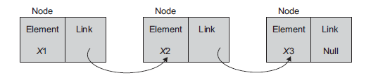
singly linked list
A linked list is an ordered collection of data in which each element (node) contains a minimum of two values,
data and link(s) to its successor (and/or predecessor).
If a node has a link only to its successor in this sequence, the list is called a singly linked list.
Each node of the linked list has at least the following two elements:
1. The data member(s) being stored in the list.
2. A pointer or link to the next element in the list.
The last node in the list contains a null pointer (or a suitable value like -1) to indicate that it is the end or tail of the list
Head

Slide 18

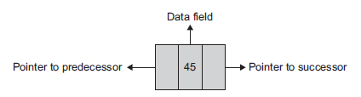
Doubly Linked list
In SLL, each node provides information about where the next node is.
It has no knowledge about where the previous node is.
For handling such difficulties, we can use DLLs where each node contains two links,
one to its predecessor and other to its successor
Each node of a DLL has three fields in general but must have at least two link fields

Slide 19

Circular singly Linked List
So far we have seen linear linked lists, Has some drawbacks
In SLL, we cannot reach any of the nodes that precede the Current node
The above problem is not the case in DLL but the problem can be solved by….
In a SLL, the last nodes link field is set to Null.
Instead of that, store the address of the first node of the list in that link field.
Such a linked list is called Circular Singly Linked List

Slide 20
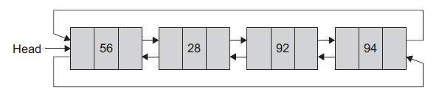
Circular doubly Linked List
In doubly circular linked list,
the last node’s next link is set to the first node of the list and
the first node’s previous link is set to the last node of the list.
This gives access to the last node directly from the first node

Slide 21
Linked list operations
The following are basic operations associated with the linked list as a data structure:
Creating an empty list
Inserting a node
Deleting a node
Traversing the list
Some more operations, which are based on the basic operations, are as follows:
Searching a node, Updating a node, Printing the node or list, Counting the length of the list, Reversing the list, Sorting the list using pointer manipulation, Concatenating two lists, Merging two sorted lists into a third sorted list

Slide 22
Insertion algorithm vs c++ implementation
void insertFront(struct Node **head, int n) {
Node *newNode = new Node;
newNode->data = n;
newNode->next = *head;
*head = newNode;
}
Insert-Front(Node head, x)
1. Create newNode
2. newNode.data <- x
3. newNode.next <- head
4. head <- newNode

Slide 23
Basic operations – insertion at the beginning of the list
Head
56
12
70
8
5
Head
56
12
70
8
5
Head
56
12
70
8
Head
5
56
12
70
8

Slide 24
Traversing the linked list
56
12
70
8
TRAVERSE-LIST(Node head)
1 cur ← head
2 while cur != Null
3 do Disp cur.data
4 cur ← cur.next
void TRAVERSE_LIST(struct Node *head) {
Node *list = head;
while(list) {
cout << list->data << " ";
list = list->next;
}
}

Slide 25
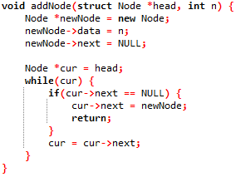
Insertion algorithm vs c++ implementation
InsertAtEnd(Node head, x)
1. Create newNode
2. newNode.data <- x
3. cur <- head
4. while cur != Null
5. do
6. if cur.next = Null
7. cur.next <- newNode
8. return
9. cur ← cur.next

Slide 26
Basic operations – insertion at the end of the list
Head
56
12
70
8
Head
56
12
70
8
5
Head
56
12
70
8
5
Head
56
12
70
8
5

Slide 27
Basic operations – insertion at the middle of the list
5
Head
56
12
70
8
5
Head
56
12
70
8
5
Head
56
12
70
8
5
Head
56
12
70
8

Slide 28
Basic operations – deletion at the beginning of the list
Head
56
12
70
8
Head
56
12
70
8
Head
56
12
70
8
Head
12
70
8

Slide 29
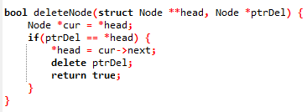
Basic operations – deletion at the beginning of the list

Slide 30
Basic operations – deletion at the middle of the list
Head
56
12
70
8
Head
56
12
70
8
Head
56
12
70
8
Head
56
70
8

Slide 31
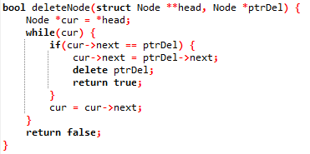
Basic operations – deletion at the middle of the list

Slide 32
Basic operations – deletion at the end of the list
Head
56
12
70
8
Head
56
12
70
8
Head
56
12
70
8
Head
56
12
70

Slide 33
Search operation in linked list
struct Node *searchNode(struct Node *head, int n) {
Node *cur = head;
while(cur) {
if(cur->data == n) return cur;
cur = cur->next;
}
return null;
}
SEARCH-LIST(head, key)
1 cur ← head
2 while cur != Null
do if cur.data = key
4 return cur
cur ← cur.next
Return null

Slide 34
Advantages of linked list over array
Advantages
1) Dynamic size
2) Ease of insertion/deletion
Drawbacks:
1) Random access is not allowed. We have to access elements sequentially starting from the first node.
2) Extra memory space for a pointer is required with each element of the list.
3) Not cache friendly. Since array elements are contiguous locations, there is locality of reference which is not there in case of linked lists.

Slide 35
Comparison of Sequential and Linked Organizations
Sequential organization The features of this organization are the following:
Successive elements of a list are stored a fixed distance apart.
It provides static allocation, which means, the space allocation done by a compiler once cannot be changed during execution, and the size has to be known in advance.
As individual objects are stored a fixed distance apart, we can access any element randomly.
Insertion and deletion of objects in between the list require a lot of data movement.
It is space inefficient for large objects with frequent insertions and deletions.
An element need not know/store and keep the address of its successive element.

Slide 36
Comparison of Sequential and Linked Organizations
Linked organization The features of this organization include the following:
Elements can be placed anywhere in the memory.
Dynamic allocation (size need not be known in advance), that is, space allocation as per need can be done during execution.
As objects are not placed in consecutive locations at a fixed distance apart, random access to elements is not possible.
Insertion and deletion of objects do not require any data shifting.
It is space efficient for large objects with frequent insertions and deletions.
Each element in general is a collection of data and a link. At least one link field is a must.
Every element keeps the address of its successor element in a link field.
The only burden is that we need additional space for the link field for each element. However, additional space is not a severe penalty when large objects are to be stored.
Linked organization needs the use of pointers and dynamic memory allocation.

Slide 37
Quiz 1
Write an algorithm for program that returns the number of the nodes in the linked list?

Slide 38
Quiz 1
Write an algorithm for program that update the a value of a node in a linked list?
Note: the node can be located anywhere in the linked list.

